Slide 1

Welcome to our
Presentation
Blood Donation and Management System

Slide 2

Introduction
Name | ID | Department | Batch | Semester | Section
Munem Sahriar | 1703310201525 | CSE | 33th | 5th | C5C
Istiyak Mahmud | 1703310201529 | CSE | 33th | 5th | C5C
Hemel Borhan | 1703310201532 | CSE | 33th | 5th | C5C

Slide 3
Introduction
In today’s everyday life, we come across many emergency situations such as accidents which cause bleeding and blood loss. Such issues create an immediate, critical need for blood supply of specific blood type as per the requirements of one in need. In addition to emergency requirements, advances in medicine have increased the need for blood in many on-going treatments and elective surgeries. This Project is to create an e-Information about the donor and finder that are related to donating blood. Though this project any person who is interested in donating blood can register himself. In the same way, if any blood finder who needs blood can send request for blood. Also a blood finder can find blood according to his needs/demand. Moreover a user can find blood bank location easily by using this software. A user can donate money for blood donation free campaign. Admin is the main authority who can do addition, deletion and modification if required

Slide 4
Motivation
We don’t want People die without life saving blood transfusions in timely. We Want TO do something for humanity.

Slide 5
Features
Features for user:
Registration and Login as a Donor.
Blood Request Send.
Searching and Finding Blood.
Send Email by smtp phpmailer.
Blood bank Location map and details.
Donate Money with Card.
Important Blogs about Blood Donation
Features for Admin:
Login as a Admin/Volunteer
Delete donor information.
Managing Donor for blood request.

Slide 6
Technology Used
Front End:- HTML,CSS, BOOTSTRAP 4
Jquery, Ajax
Backend:- Mysqli
Editor:- Visual Studio Code, Sublime Text
Server:- Xampp

Slide 7
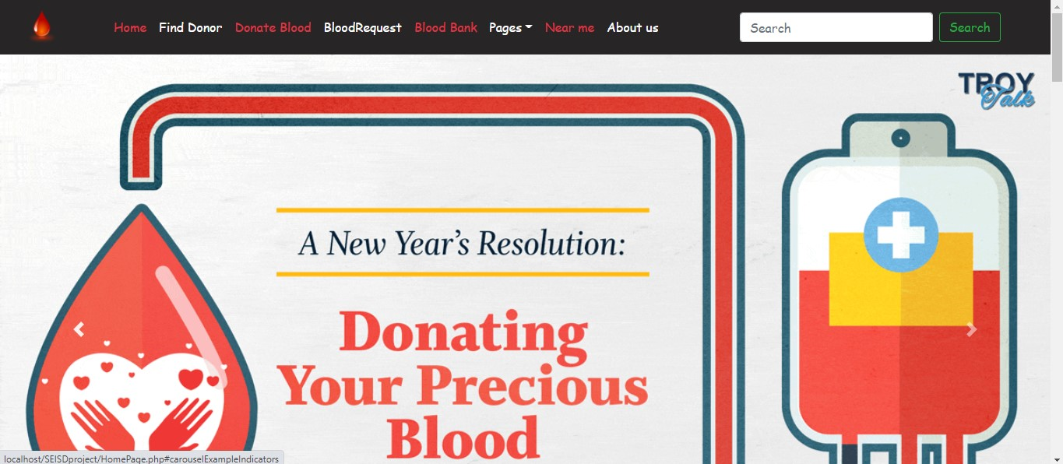
ScreenShots
HOMEPAGE

Slide 8
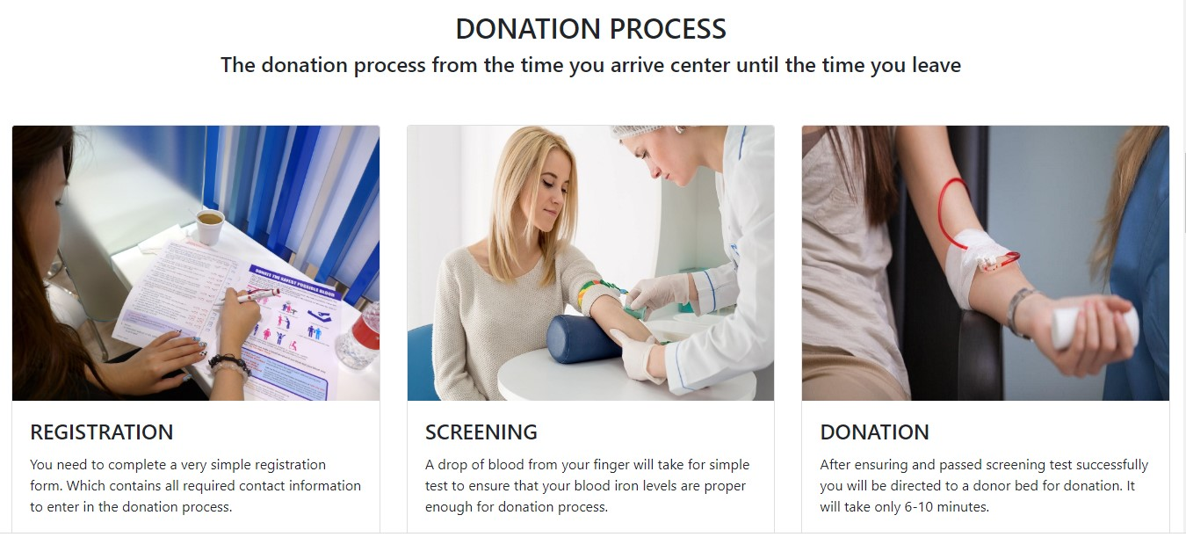
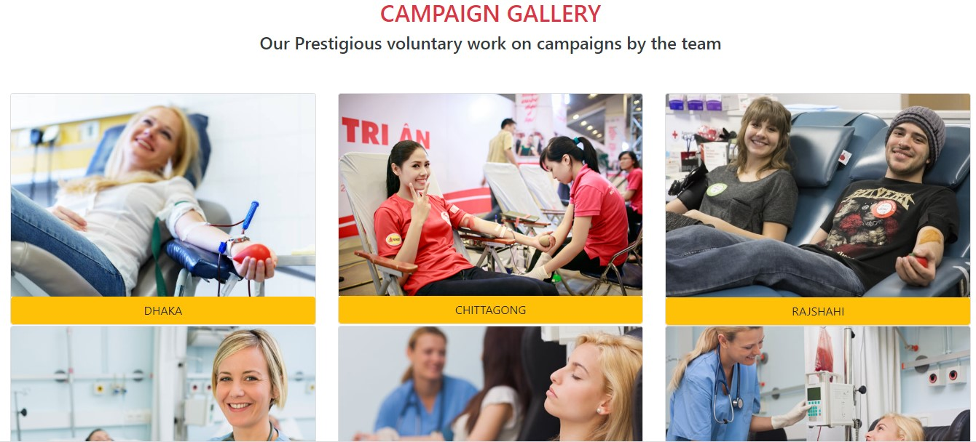
HOMEPAGE

Slide 9
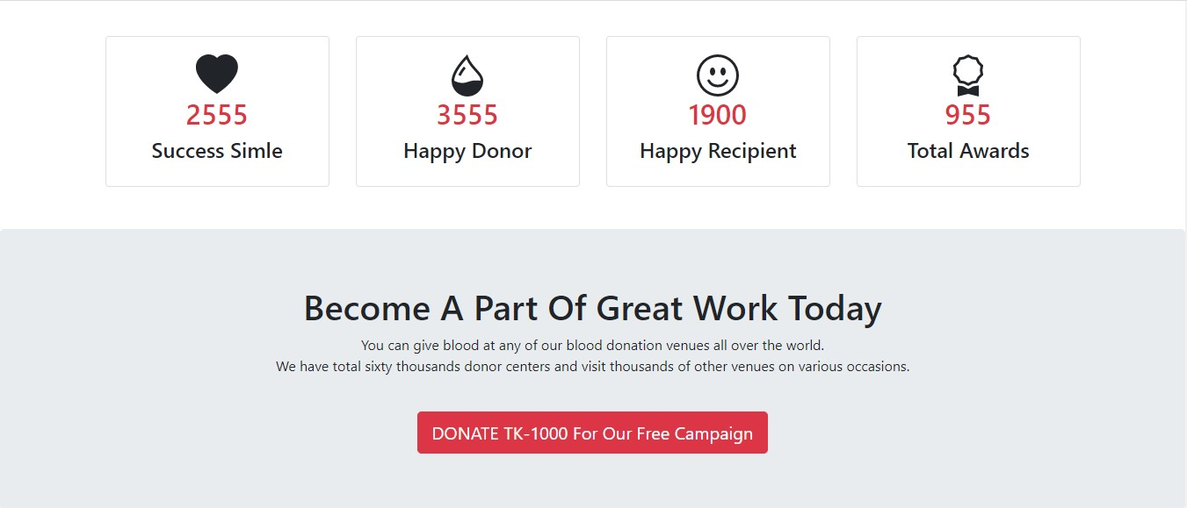
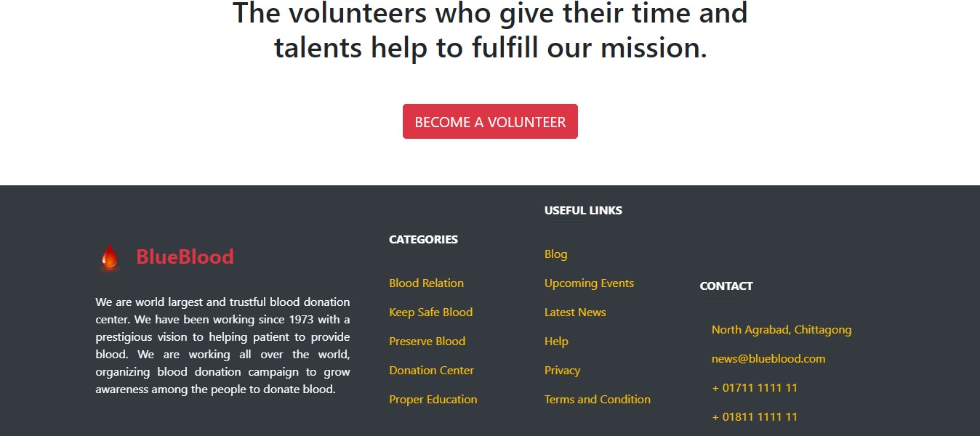
HOMEPAGE

Slide 10
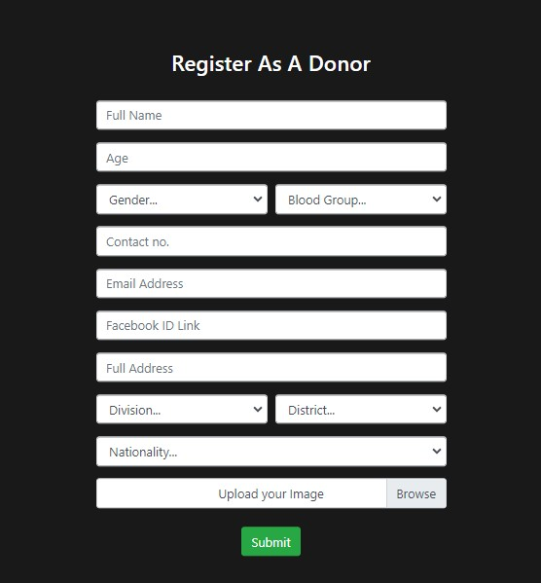
Donor registration

Slide 11
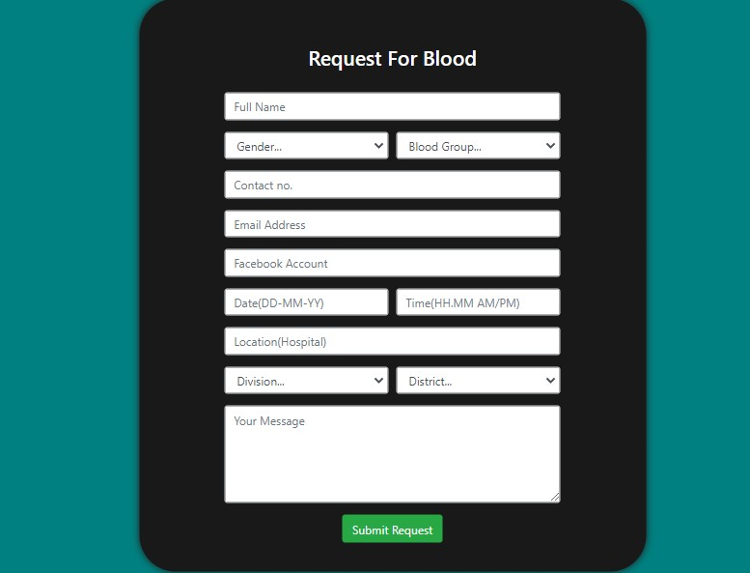
send Blood request

Slide 12
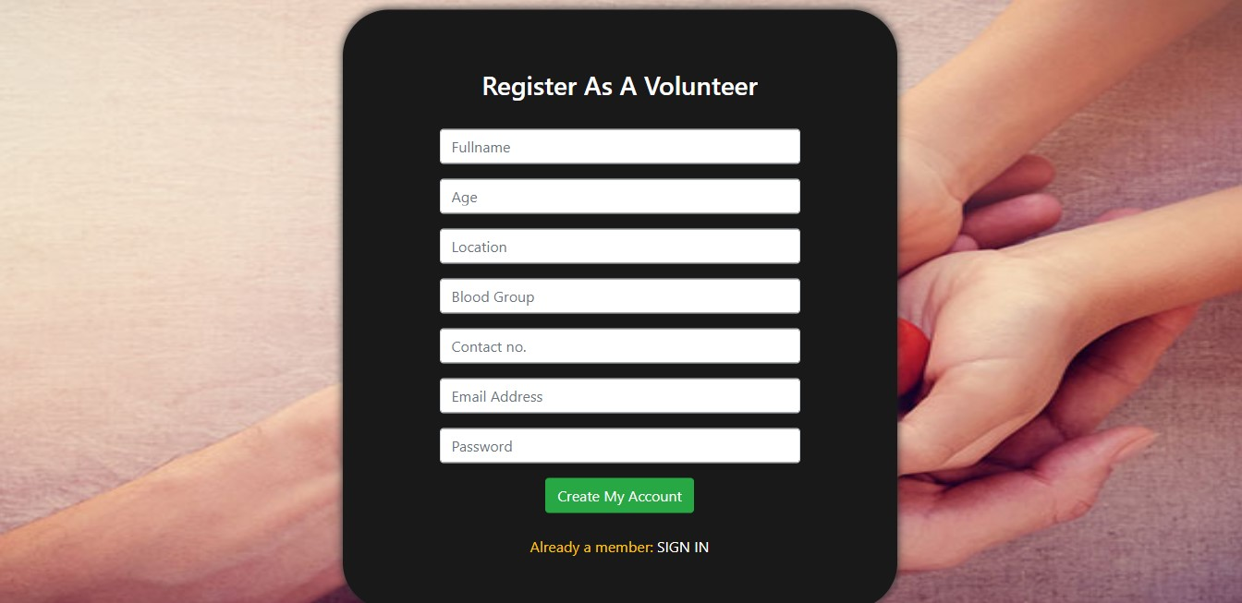
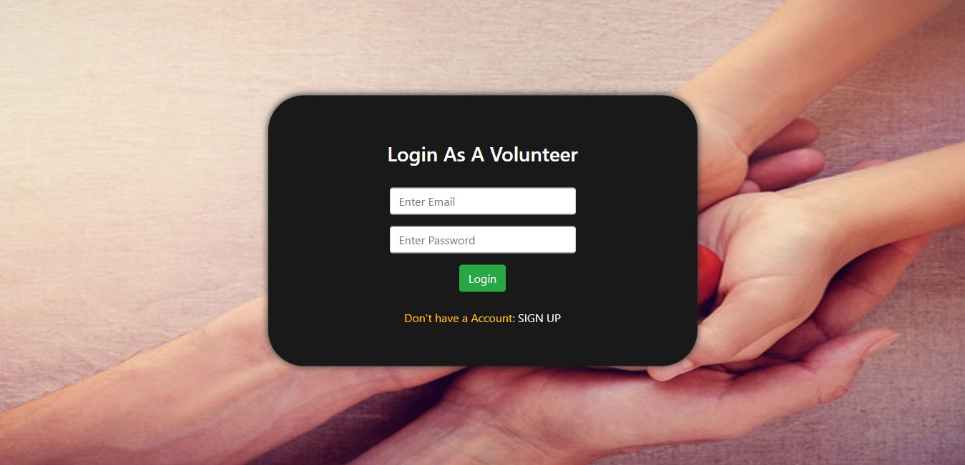
Volunteer registration & LOgin

Slide 13
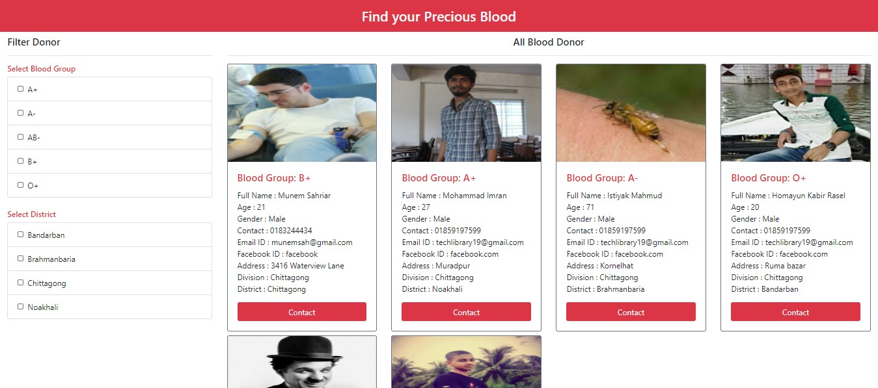
Find Donor

Slide 14
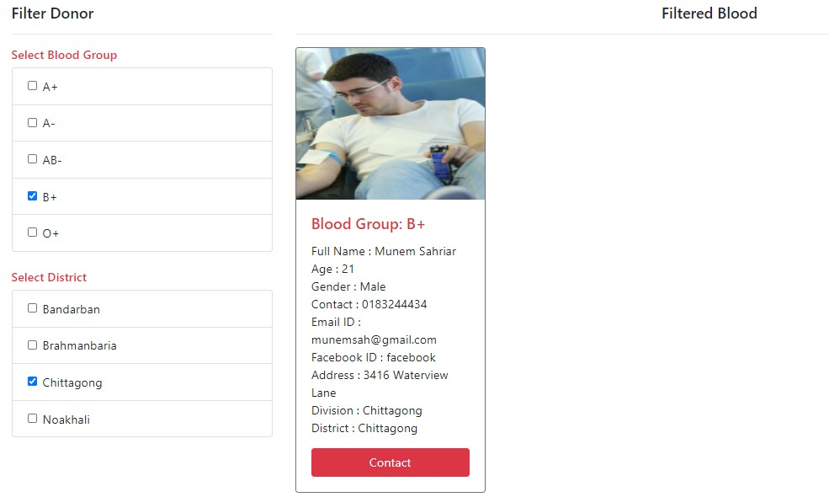
Filtered Blood–
Category Select

Slide 15
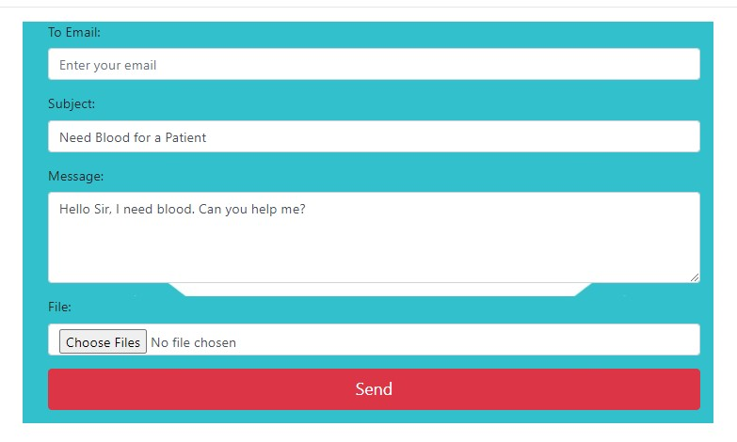
Contact – Send Email

Slide 16
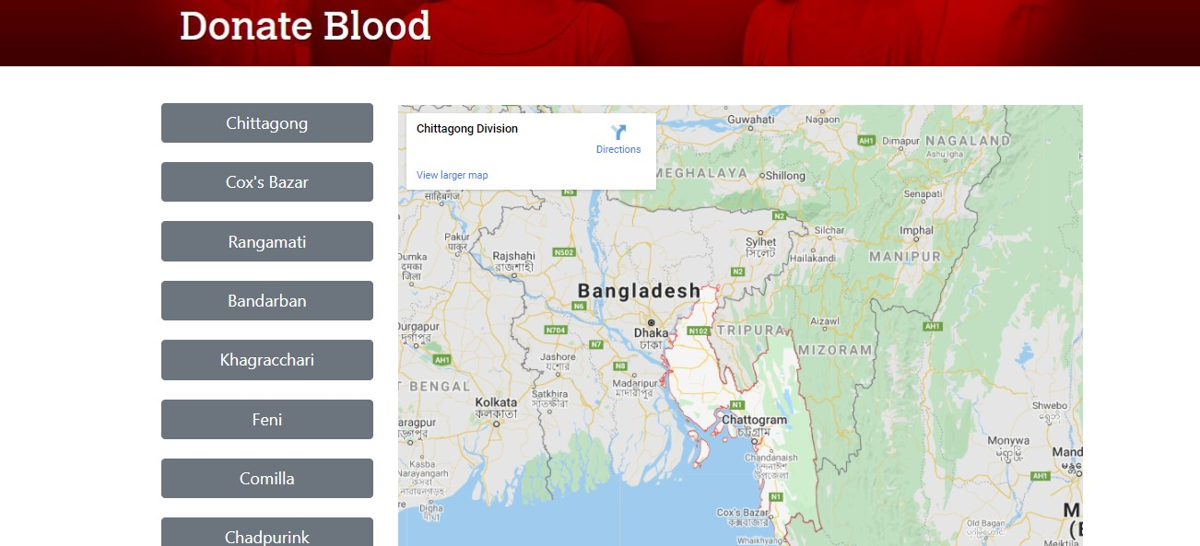
Blood Bank

Slide 17
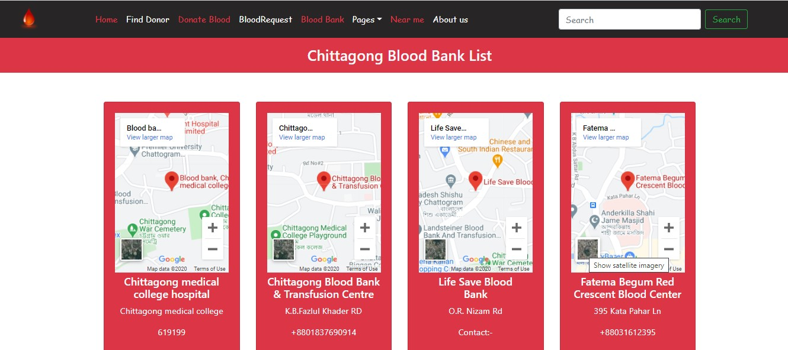
Blood Bank- Chittagong

Slide 18
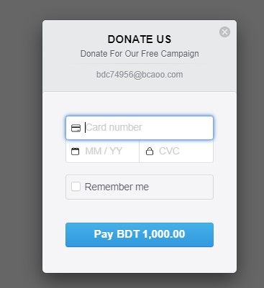
Donate Money

Slide 19
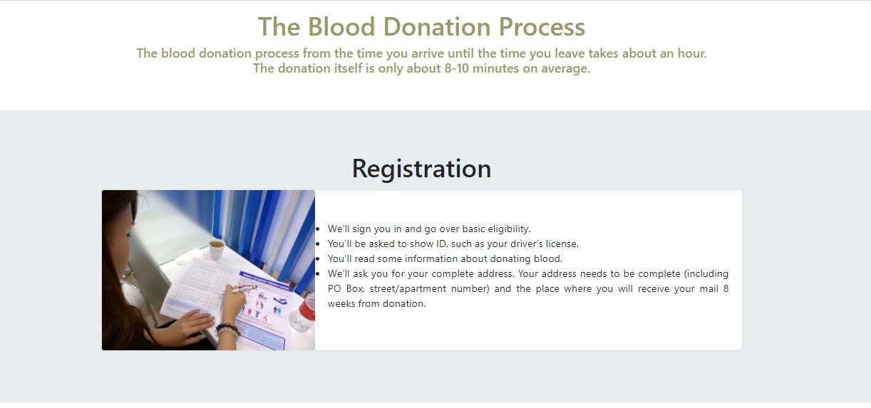
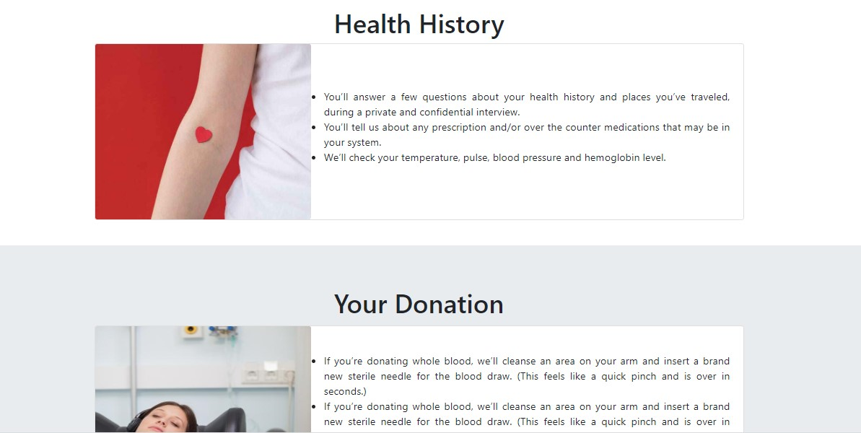
Pages- Donation Process

Slide 20
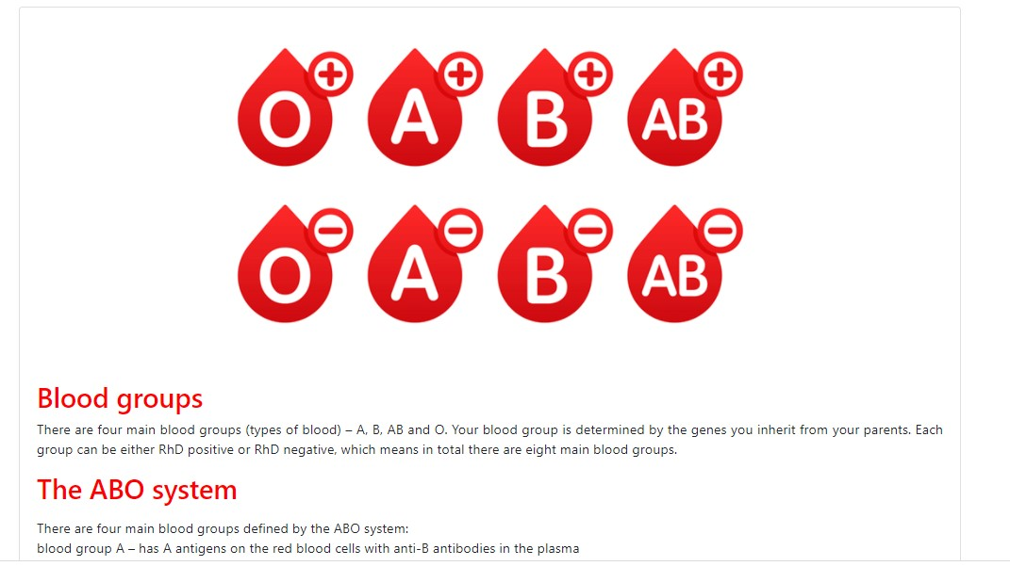
Pages-Blood Type

Slide 21
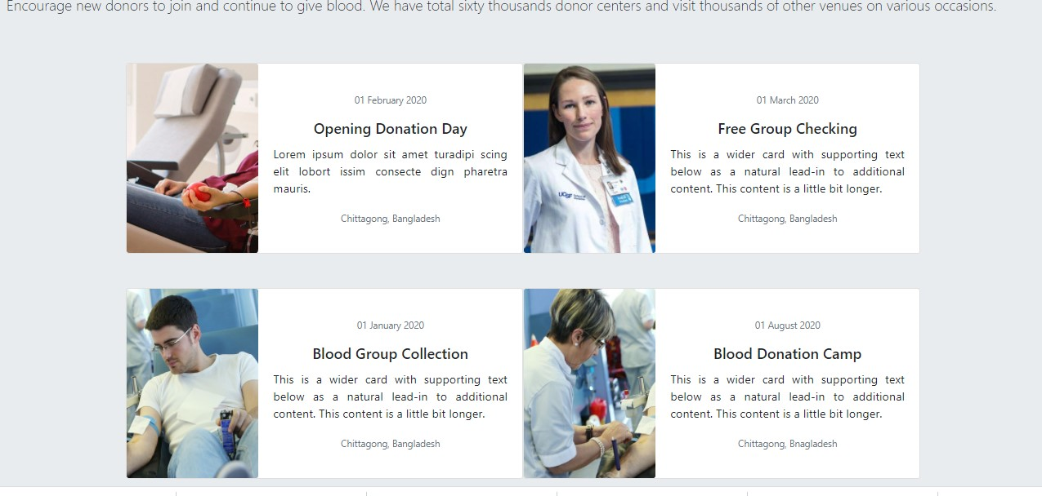
Pages-Campaign Galerry

Slide 22
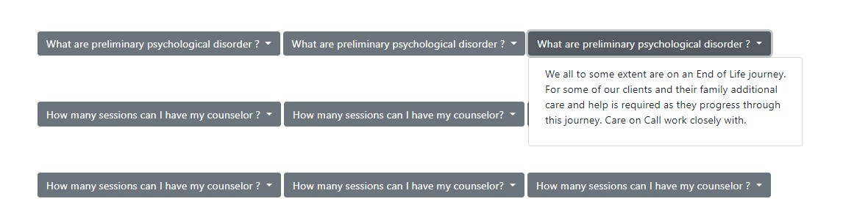
Pages-FAQ

Slide 23
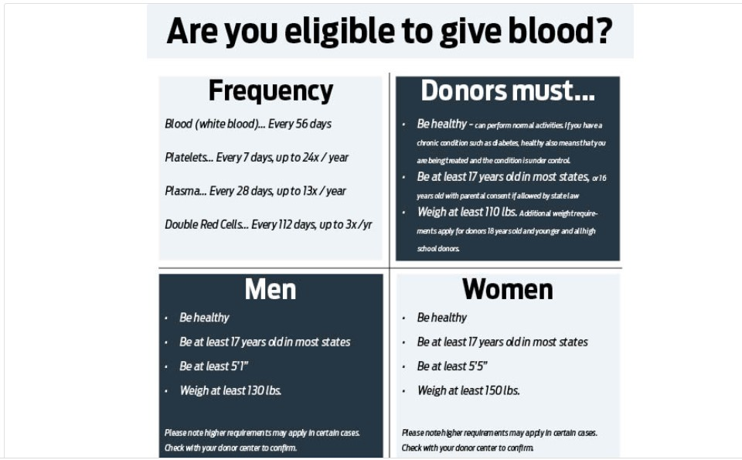
Pages- Eligibility

Slide 24
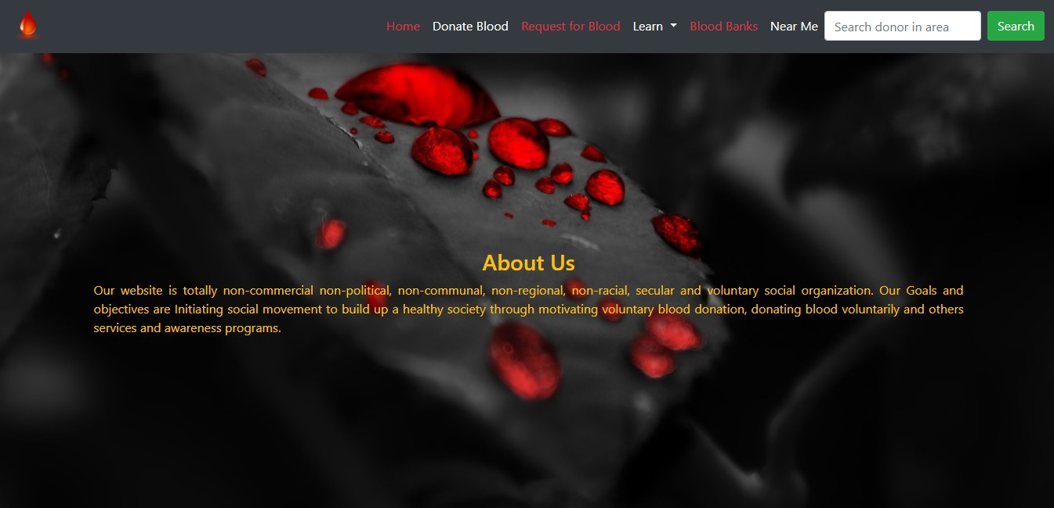
About us
`

Slide 25
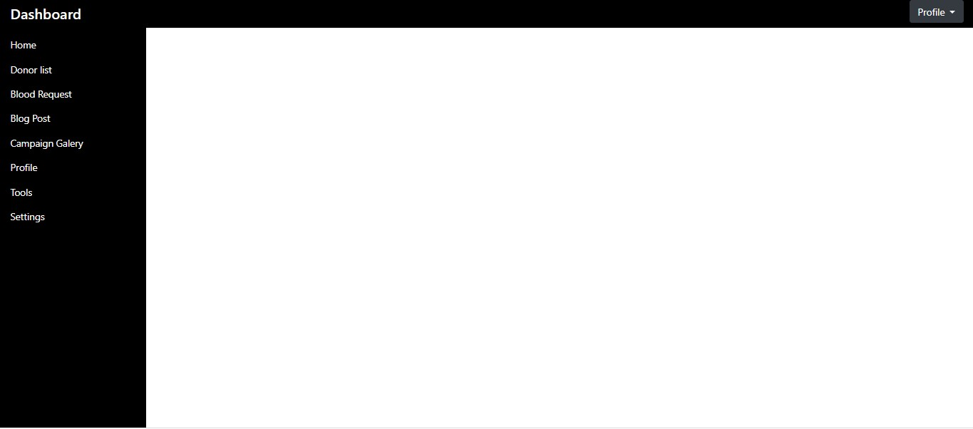
After Admin Login- Dashboard

Slide 26
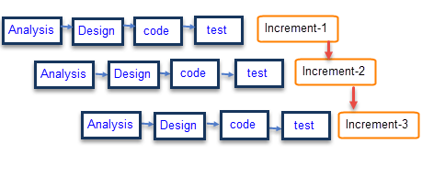
Methodology-Process Model

Slide 27
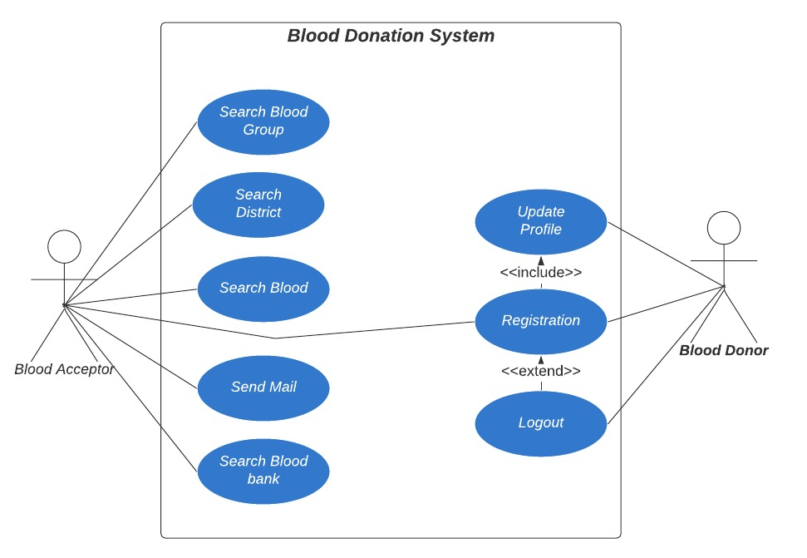
Methodology- USE CAse

Slide 28
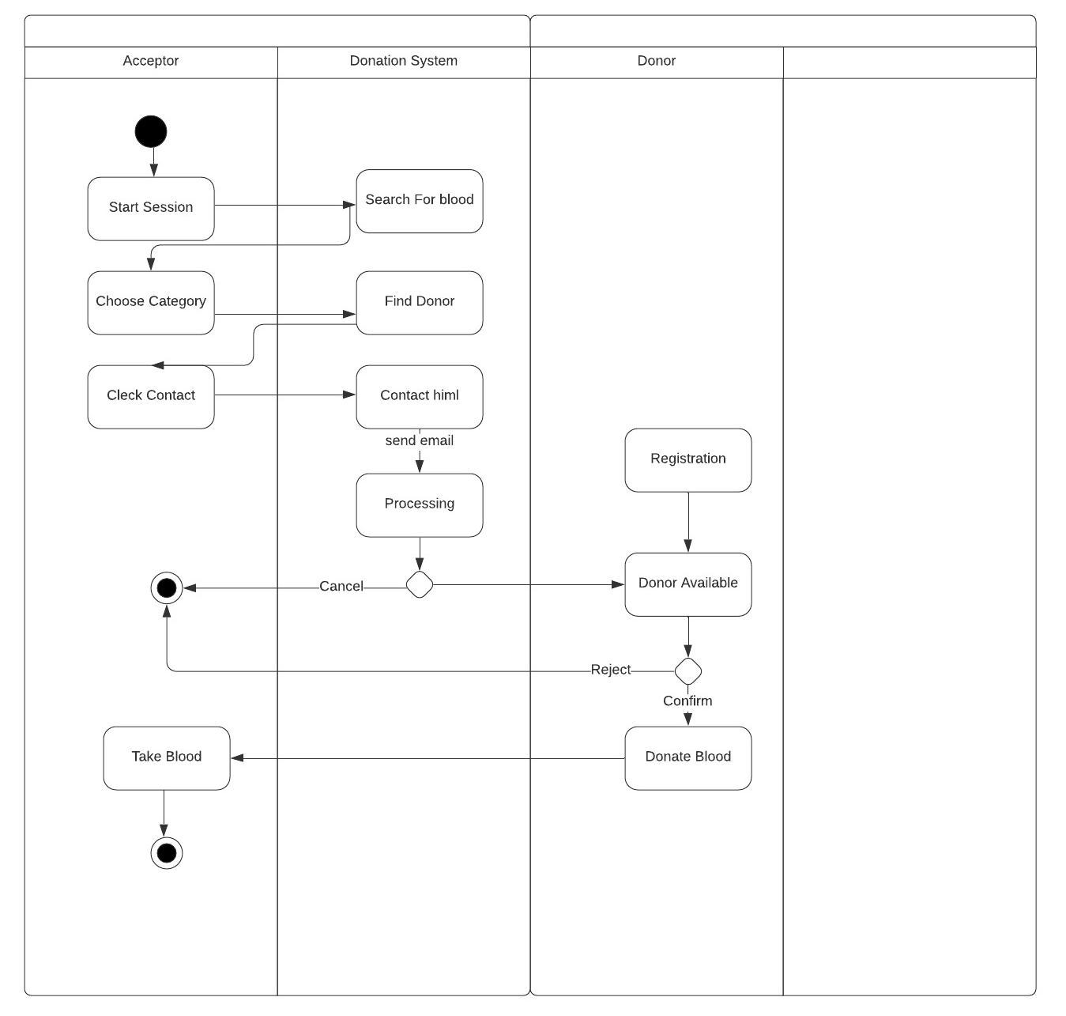
Methodology- Activity Diagram

Slide 29
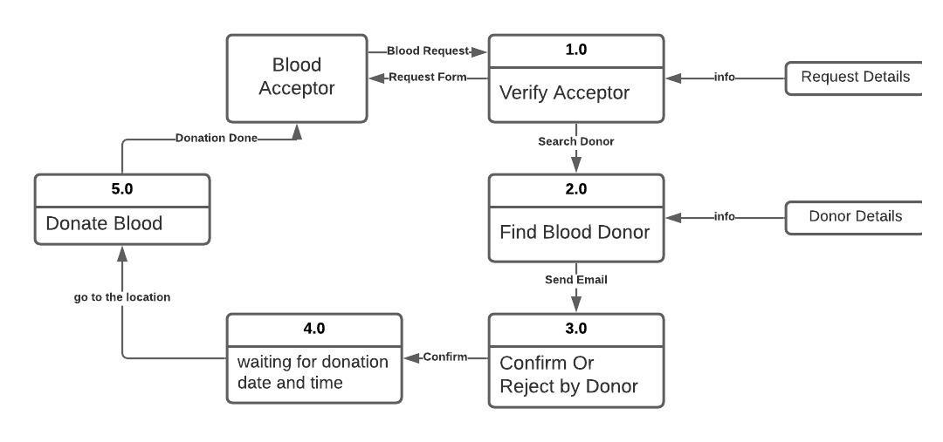
Methodology- Logical DFD

Slide 30
Limitation
Mailing system is not connected with the Contact Button(Find Filtering)
Future plan
Send Push Notification to the persons Contact Number who are selected and connection will be established.
There will be a request and accept button for sending and receiving push notification.
“Near by” Option. Blood Finder may find a donor in around 1 kilometers area.
The Complete Software will be developing for whole human Health issues. Blood Donation wills just a part of this.

Slide 31
Conclusion
The aim of this Blood Donation Software is to improve the communication with the people who are in need of blood and the persons who are willing to donate blood in few touches of Software. This Location based Blood Donation Software will reduce the barrier between blood donors and the people in sever need of blood. The donors’ location can be detected by the app and the best matched donor will be contacted in no time.

Slide 32
Reference
www.google.com
https://getbootstrap.com
https://w3schools.com
www.youtube.com
www.GitHub.com
https://lucid.app

Slide 33



Slide 34


